Slide 1


Animal Rights Extremists
Targets, Tactics, Business Response & Countermeasures
Notes:
The aim of this presentation is to provide a synopsis of animal rights extremism, including some targets, tactics, and business response measures. These “SINGLE-ISSUE” or “SPECIFIC –ISSUE” groups cause fear and distress, major property damage, and in some instances they cause physical injury, and often put lives at risk. Animal Rights Extremists (ARE) obstruct essential health advances, damage the economic well being of businesses across a variety of sectors, and undermine a democratic way of life that supports legitimate activity and the legal process.
Although incidents related to terrorism are most likely to make the front page news, Animal Rights Extremism is what’s most likely to affect your day-to-day business operations in Western Europe.
Keeping this in mind, let’s explore Animal Rights extremism in detail. (CLICK)

Slide 2

Animal Rights Extremists
Introduction
Animal Rights Extremists & Eco-extremists are closely related
AREs vs. Animal welfarists
AREs’ tactics are often successful
Targets of AREs are not limited to specific business sectors
Crossover from Europe to U.S.
Notes:
-To begin, I need to make a few points.
-The first, although I am covering a briefing on Animal Rights Extremists, this by no means minimizes the goals, tactics, and seriousness of so-called “eco-terrorists” or environmental extremists. In fact, the philosophies of both movements go hand-in-hand, and as many of you know, so do the tactics and threats. So as I talk about AREs, keep in mind that supporters of environmental extremist groups most often run in the same circles and often employ the same tactics. When a tactic carried out by Earth First or by the Earth Liberation Front (or ELF)—is successful, it will undoubtedly be shared and likely utilized by extremists in the extreme animal rights movement, and vice versa. Moreover, we’ve seen a significant crossover of those from within the anarchist movement into both the animal rights and extreme environmentalist movements. (CLICK)
-The second point I need to make is the difference between mainstream animal rights groups and the more extreme groups, which I will be focusing on today. Animal Rights EXTREMISTS believe there is no compromise to be made when it comes to animal testing for research purposes. On the other hand, animal WELFARISTS believe in the humane treatment of animals and recognize the need for animal research. They protest lawfully and seek change through education and advocacy. When I refer to Animal Rights Extremists, I am ONLY REFERING to ILLEGAL SOCIAL PROTESTERS. (CLICK)
-Third, in many instances, Animal Rights Extremists have been successful at getting companies to distance themselves from animal research and associations with research facilities. (CLICK)
-Fourth, no matter what sector your company operates in; even if your business primarily has nothing to do with animals, biotechnologies, or pharmaceuticals, do not be surprised if your company winds up being targeted by an extreme animal rights campaign. (CLICK)
-Finally, throughout this briefing, I am going to be referring to extremists from Western Europe. However, there is major crossover in aims, targets, tactics, and supporters among U.S. and European movements; therefore, in general, I will not make a distinction between the two factions. It is important to stress here that tactics that are successful in the U.S. will undoubtedly show up in Western Europe, and vice versa.
In the following slides, I will briefly address the goals of the extreme animal rights movement, the tactics and targets, and provide some countermeasures businesses have implemented in order to mitigate the threats and to minimize the potential financial loss suffered due to these radical groups. (CLICK)

Slide 3

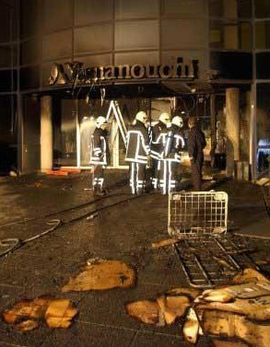


Animal Rights Extremists
History & Aims
Stop Huntingdon Animal Cruelty (SHAC)
  Commitment to closing down Huntingdon Life Sciences (HLS)
Animal Liberation Front (ALF)
Stop Primate Experimentation At Cambridge (SPEAC)
SPEAK
“SPECIESISM”
In May 2003, the European headquarters of a Japanese pharmaceutical company targeted by SHAC was firebombed by ALF (photo from SHAC web site)
Notes:
-Without going too in depth as to the history and philosophies of these groups, there is a concept and a few major groups worth noting. (CLICK)
-One concept is the idea of ‘Speciesism”. Animal rights extremists liken Speciesists to Racists and Sexists. They see the concept in very black and white terms-all living creatures are equal. To kill, eat, or use an animal in any way is the same as killing, eating, and using humans. (CLICK)
-Mindful of this ideology, animal rights extremists have long been active in the United Kingdom. (CLICK)
-In 1999 in the UK, the movement, “Stop Huntingdon Animal Cruelty” or SHAC, began targeting Huntingdon Life Sciences (HLS), an animal testing laboratory in the UK. (CLICK)
-SHAC’s stated aim is to force HLS into closure. Having failed in its initial attempt to frighten the company directors and personnel directly, the extremists then turned their attentions to secondary and tertiary targets such as HLS shareholders, customers, and suppliers. I will go into more on SHAC targets in a minute.
-In the UK, SHAC is a decentralized organization run by a handful of leaders. However, there are several cells of supporters of the movement that act in the name of SHAC but are seldom coordinated by the leadership core. SHAC is THE most prominent animal rights group in the UK and its reach is spreading across Western Europe and has already been felt back in the U.S.
SHAC shares an ideology with a number of well-known animal rights movements. (CLICK)
-The Animal Liberation Front, or ALF, is considered by the New Scotland Yard to be the shadow movement of SHAC and other animal rights factions. ALF is a movement, not a large group or institution. It is the umbrella name for all animal rights extremists. Frequently, extremists will attack SHAC targets and claim responsibility in the name of ALF.
-Unlike SHAC, ALF itself is NOT organized. ALF is the movement to commit high-level criminal acts like witness intimidation, burglary, severe destruction of property, animal release, arson, bombings, and the teaching of these tactics to others. In Western Europe, the Animal Rights Militia is also a front for violence on targets affiliated with HLS. (CLICK)
-A couple of other single-issue movements include Stop Primate Experimentation at Cambridge (SPEAC) *(CLICK)* and its offshoot, SPEAK, the Voice for the Animals. (CLICK)

Slide 4
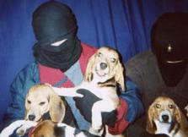
Animal Rights Extremists
History & Aims Timeline
1963 ….. Hunt Saboteurs founded
1972 ….. Band of Mercy founded (BOM)
Mid-1970s ….. U.K. ALF splinters from BOM
1977 …. Sea Shepherds begin sabotage; First ALF-claimed incidents in the U.S.
1980s-90s ….. Vandalism, fur farm raids
1992 ….. ELF actions begin in U.S.; First joint ALF/ELF claim
1999 ….. SHAC founded in U.K.
Courtesy FBI
Notes:
-As you can see from this timeline provided to OSAC by the FBI, extreme animal rights and environmental groups have existed since the 1960s. The groups became increasingly violent in the 1980s and into the 1990s. The supporters of the extreme animal rights movements are the legacy of such groups as the Sea Shepherds, Band of Mercy, and the early iterations of ALF. SHAC, although established less than 10 years ago in the U.K, is a main player in the movement today, both in the U.S. and throughout Western Europe. (CLICK)

Slide 5


Animal Rights Extremists
History & Aims
Most extremists are appear to be average, everyday people
Lifestyle choice
Websites
  Public relations, marketing SHAC: http://www.shac.net/
  Bite Back Online magazine: http://www.directaction.info/
  Animal Liberation Front: http://animalliberationfront.com/
Notes:
So, who are these people?
-By appearance supporters of AREs are generally average, everyday people. Of course, this often makes them difficult to discern on the street and during a hiring interview; thus, infiltration is common. (CLICK)
-Becoming an extreme animal rights militant is a lifestyle choice. They are dedicated to animals and are adept at getting their propaganda out to like-minded extremists. (CLICK)
-Many AREs are tech-savvy. Frequently, small groups of animal rights extremists will send photos and details of a demonstration they may have just conducted into an online SHAC mailbox. (CLICK)
-Other websites used for publicizing the movement and for identifying new targets are Bite Back (CLICK)
…and a website created for ALF (CLICK) among a myriad of others. (CLICK)

Slide 6

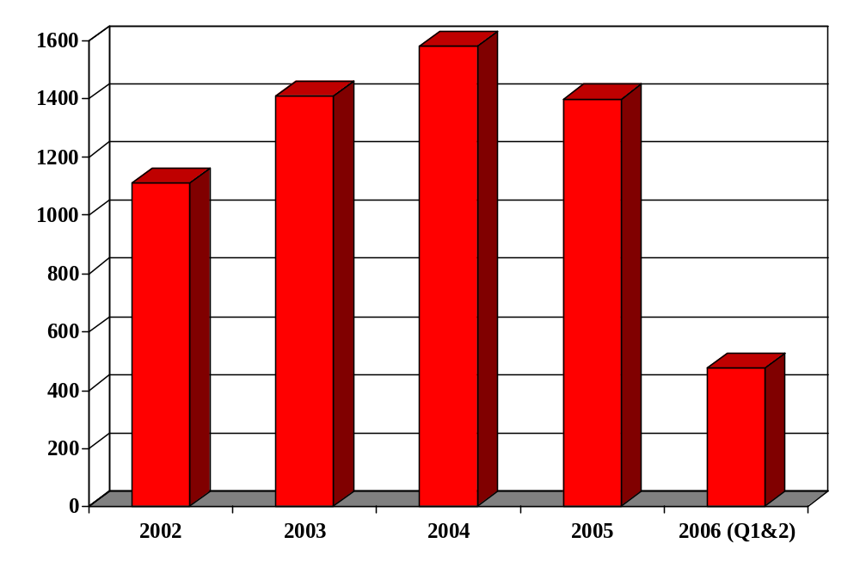
Animal Rights Extremists
A Trend
ABPI Recorded Incidents 2002-2006 (Q2)
Incidents include: threats, property damage, demonstrations, home visits, and use of incendiary devices
Notes:
-Here are some statistics for the first quarter of 2006 related to ARE activity targeting members of the Association of the British Pharmaceutical Industry (or ABPI). According to the Association, there has been a “ Sea Change” in level of attacks by Animal Extremists. They attribute this change to new legislation targeting protesters, enhanced policing, and collaboration with the pharmaceutical companies.
-The statistics shown here appear to show a decrease in ARE activity targeting the private sector. However, these stats don’t give the whole picture. Of course, since the implementation of new laws protecting businesses and residences from animal rights activists in places like the U.K. and major arrests in the U.S., one might expect the numbers of incidents to decline. That being said, this information reflects only those incidents reported by pharmaceutical companies to ABPI. (CLICK)

Slide 7

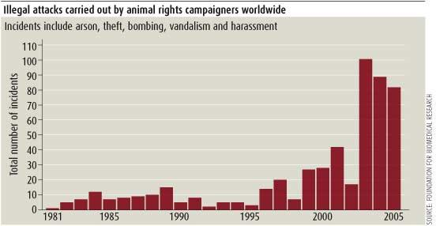
Animal Rights Extremists
A Trend
FBR Recorded Illegal Attacks 1991-2005
Incidents include: arson, theft, bombing, vandalism, and harassment
Notes:
For example, here are some statistics on SOME illegal acts committed by AREs WORLDWIDE from the Foundation for Biomedical Research. Although incidents have fallen off slightly between 2003 and 2005, you can readily see the increased trend toward more violent attacks over the past 15 years.
Moreover, anecdotal evidence and reporting furnished by a broad cross-section of OSAC constituents and by representatives with London’s Metropolitan Police suggest that although street protests are down, SHAC site visits and autonomous acts of vandalism are on the rise throughout the region.

Slide 8
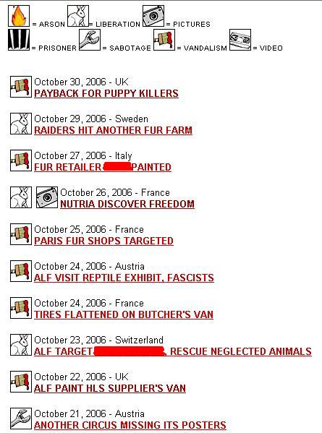

Animal Rights Extremists
Targets: General
Pharmaceutical companies
Chain restaurants/Fast food franchises
Movie studios
Government health agencies
Military/Military contractors
Targets: General
All sectors/industries vulnerable
  Agriculture
  Freight
  Biomedical
  Construction
  Financial
  Many others
Some recent actions posted on
Notes:
-Now that I’ve touched on those behind the extreme animal rights movement, I’d like to now turn your attention to the targets of the movement.
-Animal Rights Extremists target U.S. companies overseas across a variety of sectors and industries: agriculture, freight, transportation, drug, biomedical, education, construction, energy, food service, financial, entertainment, and the list goes on.
-The following are just some of the many targets of the animal rights extremist movement. Many of them are common (CLICK), such as the pharmaceutical (CLICK)
and fast-food industries.
-Other historically prevalent targets include (Click) Movie studios
-(Click) Government health agencies and
-(Click) Military and Military contractors (CLICK)

Slide 9


Animal Rights Extremists
Targets: General
Transportation services
Universities/Medical research facilities
Furriers/Department stores
Hunting guides/Fishermen
Health and beauty shops
Airlines
Notes:
-Then there are other targets one might not expect to be hit. SHAC has been successful at targeting the transportation services that are contracted to drop off HLS employees at their facilities. HLS has taxis drive personnel to the building so employees’ license plates aren’t documented by demonstrators. Of course, the various taxi companies then become obvious targets. (CLICK)
-Universities which use animals in research or are involved in genetic engineering have been targeted historically. For instance, medical research facilities in California and New Mexico have been torched in the past 5 years. In fact, ALF claimed a $1 million arson fire at Coulston Foundation's White Sands Research Center. (DON’T CLICK)
-In the UK, along with ALF, the Animal Rights group, SPEAK, has been conducting a series of attacks against firms working for Oxford University as they continue their campaign against the University’s new animal research laboratory. ALF claims to have glued and disabled card swipe devices on doors at university buildings in July and vandalized vans and premises belonging to four local contractors. An Oxford University boathouse was set on fire last year, costing hundreds of thousands of dollars worth of damages. Recent online postings suggest that any company that has any links to Oxford University, however limited, will be targeted by extremists. (CLICK)
-Other targets include furriers, athletic apparel outlets and department stores that sell furs and various leather products. (CLICK)
-Animal rights extremists hit hunting companies and intimidate even people out fishing. (CLICK)
-Extremists target businesses which sell cosmetics and health & beauty aids. (CLICK)
-SHAC is also able to determine which airlines have contracted with HLS to transport animals from the U.S. for use in lab tests. Airlines are also targeted for transporting domestic pets in the cargo holds of planes. (CLICK)

Slide 10
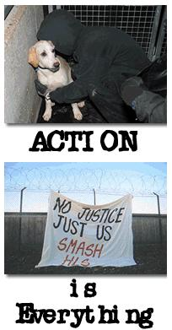


Animal Rights Extremists
Targets: HLS Customers
Customers
Suppliers
Financial support
Target Breakdown
Pharmaceutical
Biotech
Oil
Chemical
Colleges & Universities
Notes:
Taking targeting one step further, other objects of the movement are most often directed by SHAC. For example, in order to attack the financial foundation of HLS in order to ultimately shut down the facility, SHAC encourages the targeting of companies that do business-however limited or remotely-with HLS.
-Generally, SHAC makes its targets known. They breakdown targets into 3 categories, HLS customers, suppliers, and financial support. According to the SHAC website, companies involved in THESE sectors have done business with HLS at some point in time. (CLICK)
-The particular companies in the pharmaceutical, Biotech, oil, chemical, and educational sectors have been noted on the SHAC website and targeted for attack. (CLICK)

Slide 11

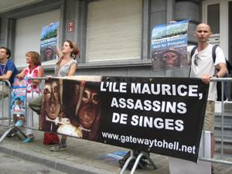
Animal Rights Extremists
Targets: HLS Suppliers
Office suppliers
Couriers
Freight services
Caterers
Medical suppliers
Document management Cos.
Landscapers
Notes:
-(CLICK) If your company ever sold a file cabinet or office supplies to HLS or an HLS contractor you may be a target. (CLICK).
SHAC goes after companies that sell or deliver supplies to HLS. If your company has ever delivered a package of any kind to HLS, HLS contractor or an employee or customer of HLS, you may be targeted. (CLICK).
-If your company ever sold equipment to HLS, HLS contractor or another research facility, you may be targeted. (CLICK).
-SHAC even targets caterers of HLS functions. -It targets logistical suppliers like (CLICK) medical companies,
-(CLICK) document management companies, and will even target
-(CLICK) landscaping businesses which are contracted to tend to the properties of research facilities. (CLICK)

Slide 12


Animal Rights Extremists
Targets: HLS Financial Support
Banks
Investment firms
Credit card companies
Accounting/Auditing firms
Notes:
-SHAC targets the financial pillars of HLS. That means: (CLICK)
-banks, which work with animal research facilities or (CLICK)
-investment firms and management companies that buy into HLS or other animal research laboratories have been targeted. Because most large corporations use 2nd party financial management companies to invest for them, some businesses that have nothing to do with the animal research industry have been hit by supporters of SHAC because their investment firms have bought shares in HLS. As mentioned on the outset of this presentation, American companies across a variety of business sectors have been harassed by animal rights extremists and this is one reason why. (CLICK)
-Credit companies (CLICK)
-and accounting firms are also hit for their associations with animal research labs like HLS. (CLICK)

Slide 13

Animal Rights Extremists
Previous Tactics (Minor)
Graffiti & vandalism
Glue door locks/Card swipes
Windows damaged
Hate mail
Denial of service attacks
Site demonstrations
  “SHAC on Tour”
“Black” faxes
Email/Phone/Letter campaigns to personnel & shareholders
“Phishing” calls
False mail orders
Boycotts
Notes:
-In the next few slides, I have separated the tactics that may be considered “MINOR” from those which may be considered more serious. However, from a benchmarking standpoint, of all of the OSAC constituents I spoke with, not one took the so-called “minor” tactics less seriously than the major ones, which will follow in subsequent slides. All of the tactics you see here and in the next few slides cost companies hundreds of thousands to millions of dollars in repair expenses, loss of contracts, loss of work hours and security upgrades.
With this in mind, let’s take a look at some of the tactics employed against American businesses in Western Europe. (CLICK)
-Graffiti and vandalism are the major nuisance crimes committed by the AREs. Windows are often broken and doors locks glued. (CLICK)
-Site demonstrations have long been a tactic of extremists. However, mobilizing several hundred supporters is difficult for the extremists. Therefore, their tactics have evolved to include only 6-10 hardcore individuals who rent cars and travel in a pseudo-convoy from one targeted site to the next and on to the next, all in one day. At each stop, they splatter the location with leaflets, bang drums, shout and chant into a bullhorn, and often attempt to intimidate the employees of the company. (CLICK)
Such tactics are referred to by SHAC supporters as “SHAC on Tour.”
-Another common tactic involves Email/phone campaigns. (CLICK)
Email “Bombs” are sent to your offices in an attempt to crash your email system. Phone calls are made at all hours of the day and night, often targeting the business, the executives’ homes, their families, their friends, and their neighbors. (CLICK)
-Another tactic is to order pornography or other offensive material and have it sent to a location with a letter identifying ALF as the sender. (CLICK)

Slide 14
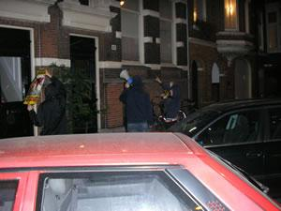

Animal Rights Extremists
Previous Tactics (Major)
Direct threats/physical assaults
Posting employees’ personal information
Videotaping employees’ family activities
Demonstrations at employees’ homes
Night visits to executives’ homes
Notes:
-Although physical assaults do occur, often actions taken against a company by SHAC and other extreme Animal Rights groups push the envelop right up to the line where another step would mean they are breaking the law. There are several reasons for this: (1) As mentioned earlier, the activists are generally average, ordinary people, with jobs and families they need to protect; (2) They do not want to get arrested, pay fines, or bring bad publicity to the cause, which they believe to be wholly legitimate; and (3) when polite demonstrating doesn’t get the message across, they wait for the more radical elements among the movement to step up the campaigns against SHAC targets in the name of ALF. (CLICK)
-Some tactics are common but vicious, like posting employees’ personal information on activists’ websites. On occasion, the credit card numbers of personnel fall into the hands of the AREs, either from breaking and entering a residence, by computer hacking or “phishing” ploys, or by rummaging through an employee’s garbage, and posting the numbers on the Internet. (CLICK)
-One disturbing intimidation tactic is to overtly videotape personnel while out with their families. (CLICK)
-These photos on this slide were posted by SHAC supporters on the SHAC website from 2 midnight demonstrations at the residences of executives from a U.S. pharmaceutical company and a courier company operating in Holland. The executives were harassed as well as their neighbors throughout the night. (CLICK)

Slide 15


Animal Rights Extremists
Previous Tactics (Major)
Infiltration
“Animal Killer”/ “Pedophile” Notices to neighbors
Burglary of office/residence
Flooding a residence with garden hose
Vandalizing cars
Notes:
-Be it an ALF supporter who gains employment at one of your facilities, or an employee who has been lured into working on behalf of the movement from the inside, infiltration techniques allow critical security and business-related information to get into the hands of extremists. Infiltration also facilitates dry-run pre-surveillance of your facilities. Thus, when protesters return, they know times, access points, which personnel to target, and oftentimes, security vulnerabilities for after-hour break-ins. (CLICK)
-An extremely sinister tactic is to plaster the neighborhood of an executive from a targeted facility with leaflets calling the individual an animal killer, like in the YELLOW flier on the opening slide of this presentation, or, in one particularly disturbing case, a child molester. (CLICK)
-Some extremists have broken into the personal residences of employees. They have left notices and intimidating threats at the scene. (CLICK)
-Extremists have broken windows and inserted garden hoses into the houses, turning the water on before leaving. Oftentimes hoses are inserted into mail slots as well. (CLICK)
-Cars of personnel have been severely damaged by these extremists. Often paint or a paint stripping agent is poured over cars owned by company employees or by vehicles owned and operated by the company. Sometimes a sledgehammer is used-there have been documented cases where an individual was still inside the car when an extremist took a sledgehammer to the window. (CLICK)

Slide 16



Animal Rights Extremists
Previous Tactics (Major)
Mail/letter bombs
Firebombing vehicles, businesses & residences
Bomb hoaxes
IIDs used by ALF
FBI Photo
ATF Photo
ATF Photo
Notes:
-Although used more in the 1990s, crude Improvised Incendiary Devices (IIDs) have been used to firebomb facilities and burn automobiles of targeted businesses. (CLICK)
-Sometimes sheds and garages are targeted as well.
-The devices are simply made from materials found at the local hardware store. Directions on how to assemble such devices can be easily downloaded on the Internet. For instance, this first photo shows *(CLICK)* a 1 gallon milk jug filled with a flammable liquid, a fuel-soaked sponge serves as the igniter, and 2 incense sticks act as the fuse.
-Typically, using IIDs or Improvised Explosive Devices (IEDs) is the tactic of last resort, after smashing cars and destroying property fails. It should be known that those individuals who resort to using bombs have in the past packed them with nails and timed them to go off such that responders to an initial blast would be targeted. (CLICK)
-Despite this threat, more common these days are hoax devices that look very similar to these IIDs, with wicks or with wires, left at a location meant to scare rather than injure. Sometimes pictures of authentic-looking hoax devices are mailed to employees. The threat to use IEDs is far more common than actual use of explosives. Oftentimes, actual hoax bombs are sent to customers of HLS causing building evacuations, police mobilization and wide press coverage. (CLICK)

Slide 17


Animal Rights Extremists
Previous Tactics (Major)
Mailing alleged poisoned/ AIDS-infected razorblades
Storming offices/Office invasions
  “Piggybacking”
Chaining shut facilities, trapping staff inside
Storming an office in Belgium
Notes:
-One U.S. company received threatening letters with supposedly AIDS-tainted razorblades positioned inside the envelopes such that whoever opened the letters ran the risk of coming in contact with the blades. (CLICK)
-Branch offices are often stormed. Protesters shout and intimidate both personnel and customers. They often state that they are not there to harm anyone but they kick over furniture, throw property around, plaster reception areas with propaganda, and steal company documents. One tactic used frequently to breach access control systems is called “piggybacking.” (CLICK)
-That is, a demonstrator enters the facility with a person who has legitimate access or using some deception, such as entering under the guise of a delivery person. (CLICK)
-On occasion, AREs have been known to chain the doors of a facility shut, briefly trapping employees inside the building where they are subjected to chanting, drumming, and oftentimes, vandalism. Sometimes they block exit gates with old cars in order to trap staff inside. (CLICK)

Slide 18

Animal Rights Extremists
Previous Tactics (Major)
Targeting lower-level personnel
Reconnaissance
  Small cells
Disguises, photos and videos of vandalism
  Recruitment
  Marketing
Extremists often videotape operations
60 MINUTES, November 13, 2005, “Burning Rage”
Notes:
-One particularly successful technique employed by AREs is the targeting of lower-level personnel who have no expectation of being harassed. The tactic evokes a higher emotional response from these employees than attacks on corporate executives who know that harassment often comes with the position they hold. Targeting lower-level employees takes a tremendous psychological toll on the whole company. (CLICK)
-Similar to tactics utilized by traditional terrorist cells, many ARE operations are conducted only after several weeks of reconnaissance have been performed. Typically, for operations that require breaking and entering, animal release, destruction of property and the theft of proprietary information, the extremists work in small teams of only 5 or 6 trusted individuals. (CLICK)
They often videotape their actions or take pictures to publicize, to recruit support for and to market the movement on their websites. (CLICK)

Slide 19



Animal Rights Extremists
Previous Tactics (Major)
Intimidation
Threat of product contamination
Using untraceable equipment
Sabotaging air conditioning systems
Holding training workshops on tactics
Notes:
-Intimidation is a major tactic utilized by AREs. For instance, one threat was discovered by an executive from a financial consulting firm *(CLICK)* upon his return home from an outing with his family.
-AREs left leaflets and a subtle threat in the driveway in the form of the head off of the family’s snowman. (CLICK)
-There are often threats of product contamination. Similar threat tactics are used by anti-globalization activists and radical environmentalists. (CLICK)
-One tactic often used by the AREs is to conduct vandalism or break-ins using equipment they’ve stolen from hardware stores or construction sites. If they purchase tools, they will wear gloves. Additionally, extremists will wear gloves while assembling IIDs or when committing acts of sabotage at a targeted facility or residence. They use these tactics so their involvement cannot be traced. (CLICK)
-One company had their air conditioning system sabotaged by an Improvised Explosive Device. (CLICK)
-It’s important to note that successful tactics are shared among individuals and supporters of the animal rights movement. (CLICK)

Slide 20

Notes:
-In order to facilitate the sharing of tactics, groups sometimes hold organized mainstream events, where likeminded individuals can come together and share tactics, best practices, and form alliances. There are national conferences like this one held here in the Washington D.C. area in August. Although many legitimate activists attend these events, the conference holds workshops on successful tactics used against your companies, which are likely attended by extremists as well.
-In Europe, according to press reports, in June of this year, AREs held a training camp at the Friend Farm Animal Sanctuary in the U.K. for animal rights extremists. The camp trained participants on tactics and demonstrations, including classes in potentially lethal physical techniques that are described as “self-defense.” According to the press report, at similar camps in the past, activists were taught how to deliver punches to key areas of the body and to damage optic nerves by sticking their fingers into adversaries’ eyes. Other workshops included “How Companies Deal with and Avoid Protests”, Planning and Carrying Out Effective Demos”, and “Working Undercover.” Press reports state 300-400 individuals attended the 4-day event.
-It is through events such as these that extremist tactics are further exported throughout Western Europe and back to the U.S.

Slide 21
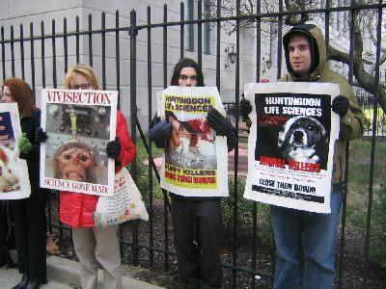

Animal Rights Extremists
Significant Events
NJ “SHAC 7” Trial
Darley Oaks Farm
Donald Currie arrest
England & Wales legislation
Dr. Jerry Vlasak: “By any means necessary.”
SHAC Supporters Outside NJ Courthouse
Vlasak
Notes:
-There have been several significant events affecting the ARE movement. (CLICK)
-The SHAC 7 trial in NJ cast a severe blow to the movement, particularly in the U.S. The defendants encouraged others to conduct a campaign of harassment and intimidation against HLS employees and tried to force the company out of business through acts of vandalism, stalking and computer hacking. The indictment further charged that SHAC targeted employees and shareholders, as well as companies that provided services to HLS, by posting personal information on its website and encouraging followers to “operate outside the confines of the legal system.” The defendants are the first people to be convicted in New Jersey under the Animal Enterprise Protection Act – amended in 2002 to include “animal enterprise terrorism” – which outlaws the disruption of research firms like HLS.
According to press reports: “Sentenced Sept. 12 were Kevin Kjonaas, Lauren Gazzola, and Jacob Conroy. Kjonaas, the former president of SHAC USA, was sentenced to 72 months in prison; Gazzola, the group's campaign coordinator, to 52 months in prison; and Conroy, a coordinator and SHAC USA's Web site manager, to 48 months in prison. In separate hearings later that month, Joshua Harper, Andrew Stepanian, and Darius Fullmer were sentenced. Harper, SHAC USA's West Coast coordinator, and Stepanian, the organization's New York coordinator, each received a 36-month prison sentence, and Fullmer, a conspirator, received a one-year sentence. (CLICK)
-Activists in the UK dug up the remains of a woman whose family owned a guinea pig farm in October 2004. Three extremists held the remains of Gladys Hammond hostage for a short time before being arrested in May of this year. Hammond was the mother-in-law of the owner of Darley Oaks Farm, a guinea pig breeding farm, which was the target of a six-year campaign by animal rights extremists. The campaign targeted the owners, their friends, acquaintances, and business associates, culminating in the theft of the remains. The three involved in the theft of the body were jailed for 12 years each. The remains were recovered but the family is no longer involved with the farm. (CLICK)
-Donald Currie, described as ALF’s main ACTIVE bomber was arrested in the UK and plead guilty to four charges of arson, one of attempted arson, and two counts of possessing explosives with the intent to carry out further arsons. Currie was arrested on March 26th after trying to bomb a car belonging to the husband of the director of a courier company working with HLS. The explosive—which did not detonate—was a mixture of sodium chlorate, a commonly available weed killer, and sucrose. On Sept. 7 of 2005, Currie placed an explosive device on the porch of the corporate comptroller of a large American pharmaceutical company in the UK, while his wife and daughter were inside the house. (CLICK)
-In England and Wales, Sections 125, 126, and 127 of the Serious Organized Crime and Police Act 2005 have tightened laws significantly. The legislation is meant to address the harassing and intimidating behavior of animal rights extremists. The Act clarifies what harassment is and applies criminal offences for those who meet the criteria for intimidation and harassment. This legislation has helped to decrease protests at residential homes in England and Wales. (CLICK)
-Dr. Jerry Vlasak has become an icon of the Animal Rights movement. Vlasak--a Los Angeles medical doctor and spokesperson for the Animal Liberation Front (ALF), recently stated that killing individuals associated with the killing of animals is morally justified. His profession as a physician and his notoriety with the media has made him a major voice among extremists.
-When asked by a reporter if it would be okay to use violence against seal killers, Dr. Vlasak has said, "I believe that violence in defense of innocent animals would be morally justified -and I am simply making the beliefs of thousands of animal rights activists public. … If it were your child or companion being clubbed to death, would violence in self-defense not be morally justified in order to stop it?” (CLICK)

Slide 22
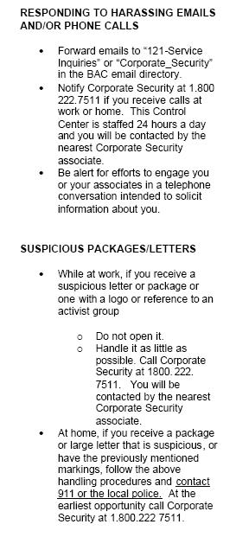

Animal Rights Extremists
Business Response & Countermeasures General Security Procedures
Training
  Personnel
  Local law enforcement
Approach executives “softly”
Injunctions
Scan activist websites
Notes:
In response to the tactics outlined in this presentation, companies have implemented several business response plans and countermeasures. Because one of the concerns security managers have is how to balance safety and security within the budget allotted by corporate, these countermeasures need to be assessed for practicality by individual security managers. Still, elements of even the most costly measures should be considered. (CLICK)
Companies have stated that it is critical to invest in training. (CLICK)
Companies that have been targeted in the past are training their receptionists, contract security forces, and other personnel on how to react without overreacting during both violent and non-violent demonstrations at their facilities. If you use contract uniformed security, be certain they are on the look out for suspicious packages, unattended briefcases, or backpacks. In order to control anxiety among your executive staff, it would be a good idea to brief your mail handlers on SHAC tactics and have them identify and capture suspicious letters before they make their way to the executive floor. (CLICK)
It is important to actively engage law enforcement. Some companies have collaborated on workshops for law enforcement and federal authorities. The annual workshops are designed to continually educate authorities on the threats and the impact AREs have on local businesses. (CLICK)
Many OSAC constituents have reiterated the necessity of approaching executives “softly” when a threatening letter is received, which targets the individual or his family. You need to approach the threat by understanding the “real” versus the “potential” risk to the executive while being sensitive to the unique personality of the executive, all without being unnecessarily alarmist. Even if the threat is minor, executives often get extremely nervous when their families are mentioned. (CLICK)
Also, make it a point to remain vigilant and proactive. If you feel you might be a target of a campaign, you should search the extremists’ websites for any mention of your company. But be aware: extremists have been known to monitor traffic to their sites. (CLICK)

Slide 23

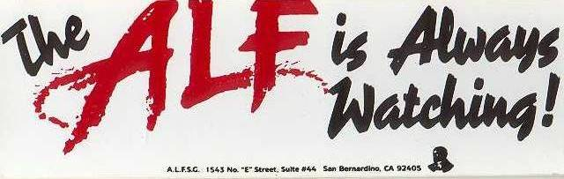
Animal Rights Extremists
Business Response & Countermeasures General Security Procedures
Do not put pictures of personnel on website
  No home addresses, cities
  No alma maters
Do not put family photos on website
  No company photos
Notes:
With so much information readily available on the Internet, you should anticipate that company information will reach extremists. Most of this information is used by extremists to disclose company secrets, disrupt partnerships, jeopardize company finances, and expose activities that may reflect negatively on the company and staff. (CLICK)
One big mistake companies make is posting the pictures… (CLICK)
…and home addresses of their executives on the company Website. This makes it too easy for extremists to locate, identify, and target your personnel. Make sure the children of your personnel aren’t posting pictures and occupations of their parents or family members in chat rooms or on sites like My SPACE and FACE BOOK.com (CLICK)
Don’t provide the name of the executive’s alma mater on your website (CLICK)
Same holds true for family photos. Don’t put wedding photos, family vacation photos, *(CLICK)* or company outing photos on your websites. (CLICK)

Slide 24
Animal Rights Extremists
Business Response & Countermeasures General Security Procedures
Notify family members
If followed, DO NOT RETURN HOME
Consider changing phone number
Consider changing route/time to work
Do not leave any identifying information in car
Do not dispose of personal information in trash
Notes:
-Notify family members as they might receive phone calls. Family members should be advised not to give out any personal details to anyone. They should be told to be vigilant and to look out for suspicious mail. Suspicious mail should not be opened and most certainly such items should be kept out of reach of children. (CLICK)
-If employees feel they are being followed, they should not return home. If a cell phone is available, advise them to call the police and company security. If possible, they should drive to a police station or a large gas station-preferably one with surveillance cameras-and ask the attendant to call the police. (CLICK)
-Because extremists research the identities of employees of targeted companies in order to learn as much about them and their work as possible, targeted personnel may want to change or unlist their phone numbers. If a company is targeted, it would be advisable for high profile personnel to remove their names from their mailboxes at home. (CLICK)
-Employees should be encouraged to vary their routine. Change the routes driven to work and vary the times of departure to and from work. (CLICK)
-Do not leave any items in cars that can be used to identify personnel. This includes mail, business cards, company permit stickers, and lap tops. (CLICK)
-Do not throw away bills, junk mail or anything that confirms the identity of a targeted employee in the trash at home. Extremists will go through a garbage can for this information. (CLICK)

Slide 25
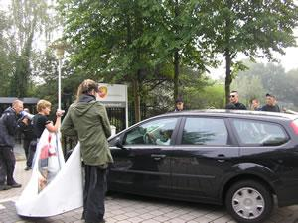
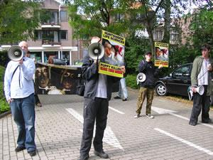
Animal Rights Extremists
Business Response & Countermeasures General Security Procedures
Do not engage protesters
Lock doors and close windows
Call local law enforcement
Notify neighbors!
Increase patrols
OSAC Country Council program
Notes:
When demonstrations occur at your place of business or if protesters visit the homes of your executives… (CLICK)
Never confront the protesters. Do not start a conversation with them and never get aggressive with them. These individuals are clever. Most of them know what their rights are and as such, commit acts of nuisance that come right up to the line without crossing it. As soon as you become aggressive with them, they may initiate legal proceedings against you personally. Therefore, it is much wiser to let the authorities handle protests outside your facilities. (CLICK)
At home and at work, keep doors and windows locked and closed when driving past demonstrators. Keep shades or curtains drawn at home. (CLICK)
Remind personnel to call the police at first signs of protest activity. Have a POC with local LE so you could be notified prior to a demonstration and sufficient police presence can be summoned. If calling law enforcement from home, be certain employees wait for the arrival of police and be SURE they ask for identification. (CLICK)
When an employee is away from home, the first line of defense against break-ins and vandalism is informed neighbors. The neighbors should be educated on the movement and given phone numbers to both contacts within your company and local law enforcement (CLICK)
Many companies have increased patrols around executives’ residences at the first hint of home visits. Many have coordinated with local neighborhood watch groups. (CLICK)
Overseas, the country council program supported by the Regional Security Office at the embassies and consulates could be used as a way of communicating threats, incidents and best practices among security managers. The more ideas and information that are shared the better equipped you will be in the event your company becomes a target of an extreme animal rights campaign. (CLICK)

Slide 26


Animal Rights Extremists
Business Response & Countermeasures Physical Security Procedures
Surveillance cameras/teams
Close off mail slots & unnecessary vents
Additional lighting
Alarm system
Have offices cleaned during the day
Notes:
Although somewhat costly, it would be a good idea to install security cameras at facilities and even at the residences of high-profile personnel. Be certain existing cameras are recording properly.
Some companies have even implemented surveillance detection teams around the company’s facilities and in some residential communities. The SDTs identify and often photograph extremists for use as evidence in court cases or for local law enforcement. (CLICK)
Close off mail slots and unneeded vents at close of business. Install covers over needed vents to make them inaccessible to vandals. (CLICK)
Determine whether your facility is well-lit at night; you may assess that your facility needs more lighting outside of the facility. Additional lighting will also deter other criminal acts not associated with AREs. (CLICK)
Install an alarm system that detects breaking glass on windows and doors. Make sure alarm company has updated emergency phone numbers of staff to call in the event of a break-in. (CLICK)
In order to prevent infiltration at night, have offices cleaned during the day and make certain cleaning staff do not have access to security alarms or authorization to turn them on or off. (CLICK)

Slide 27
Animal Rights Extremists
Business Response & Countermeasures Physical Security Procedures
Do not admit unexpected repairmen or delivery persons
Do not allow visitors access to secure areas
Install deadbolts/“Buzzer” entry systems
Escape routes/Evacuation procedures
Involve local authorities into your security planning
Notes:
-Don’t admit unexpected repair or delivery persons into the facility.
-Keep secure areas free of visitors and uncleared personnel. Distribute visitor badges or create visitor escort procedures. (CLICK)
-Consider installing deadbolt locks on office doors leading to hallways and other public areas. Consider using a “buzzer” entry door system. (CLICK)
-Familiarize employees with escape routes and evacuation procedures. Hold drills at regular intervals. (CLICK)
-Involve local law enforcement or a security consultant to visit your business and ask them to review your floor plans and security measures. Talk about the potential for attacks and discuss strategies for prevention. Be sure to notify the regional security officers nearest your facility, OSAC, and other appropriate USG law enforcement entities. (CLICK)

Slide 28
Animal Rights Extremists
Takeaways
AREs target U.S. businesses overseas from nearly every sector and industry
ARE tactics are calculating, persistent and often effective
Personnel training is critical
Proactive security measures mitigate financial loss
Utilize the OSAC Country Council program overseas for information sharing, best practices
Notes:
-There has been quite a bit of information presented here today, including quite a few takeaway points.
-AREs target U.S. businesses overseas from nearly every sector and industry.
-Tactics are calculating, persistent and often effective.
-Training on tactics and appropriate business responses should be conducted at all levels of personnel.
-Preparation and proactive security measures could mitigate financial loss.
-The Country Council program is a great resource for sharing information, lessons learned, and best practices among overseas security managers.

Slide 29

Animal Rights Extremists
Targets, Tactics, Business Response & Countermeasures
To report incidents or to receive further information on Animal Rights Extremists contact OSAC
OSAC.GOV
Notes:
I’ve tried to briefly present a selection of aims, targets, tactics, and business countermeasures today. If you have further questions of would like to receive additional information on animal rights extremists, please contact OSAC. (CLICK)
Thank you very much for your time.

